Slide 1
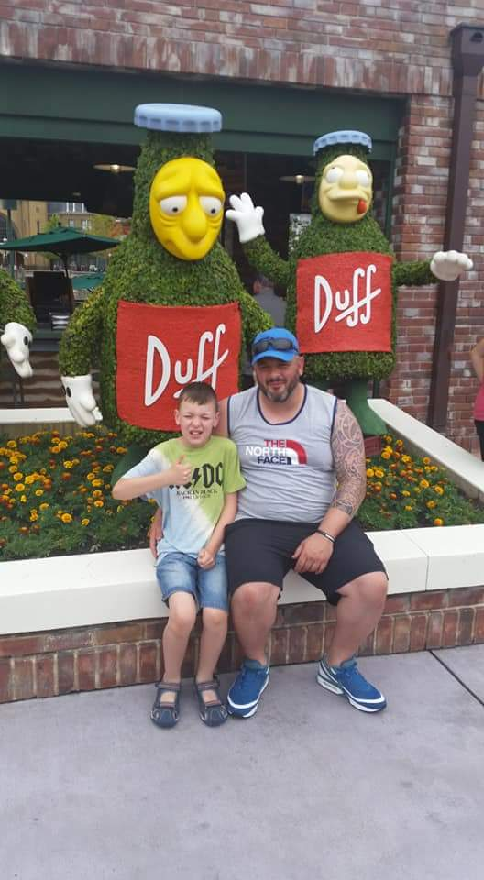
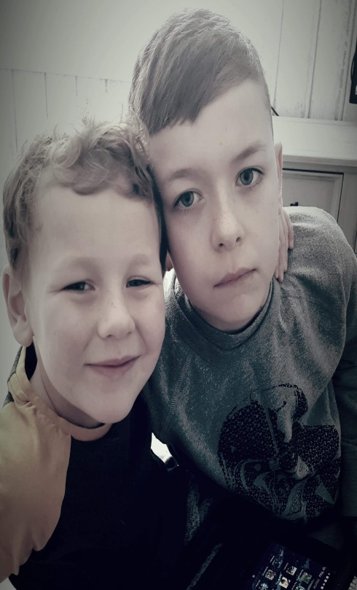
This is me
I am Charlie.
I am 11 years old.
I live with my Mum and Dad, Lauren and Barry.
My brother is called Finn.
I have two dogs called Millie and
Reggie

Slide 2
Things you need to know about me
I can hear you and I understand most things that are said to me.
I communicate using my Ipad.
I can use some signs to communicate.
I may not always look at you but I know you are there.
You may not think I am listening but usually I am.

Slide 3
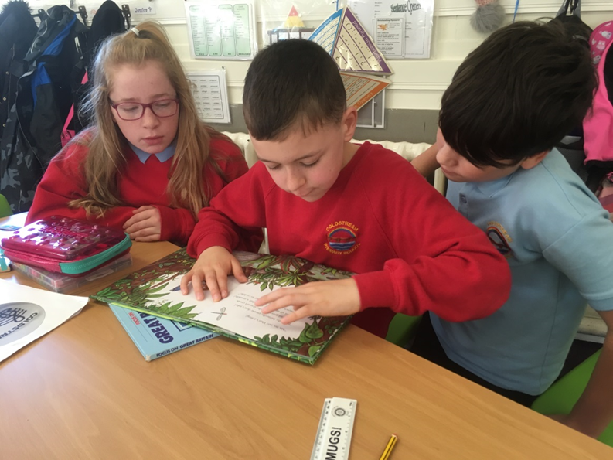
Things I find difficult
Looking at people – I don’t like to – I find it uncomfortable
I am sensitive to
noise
smells
some tastes
some things I touch
I don’t react the way you do.
I find making friends difficult as I don’t really play the same way you do but I do enjoy being involved with other people.
Don’t be nervous about speaking to me – just chat away . I will be listening.

Slide 4
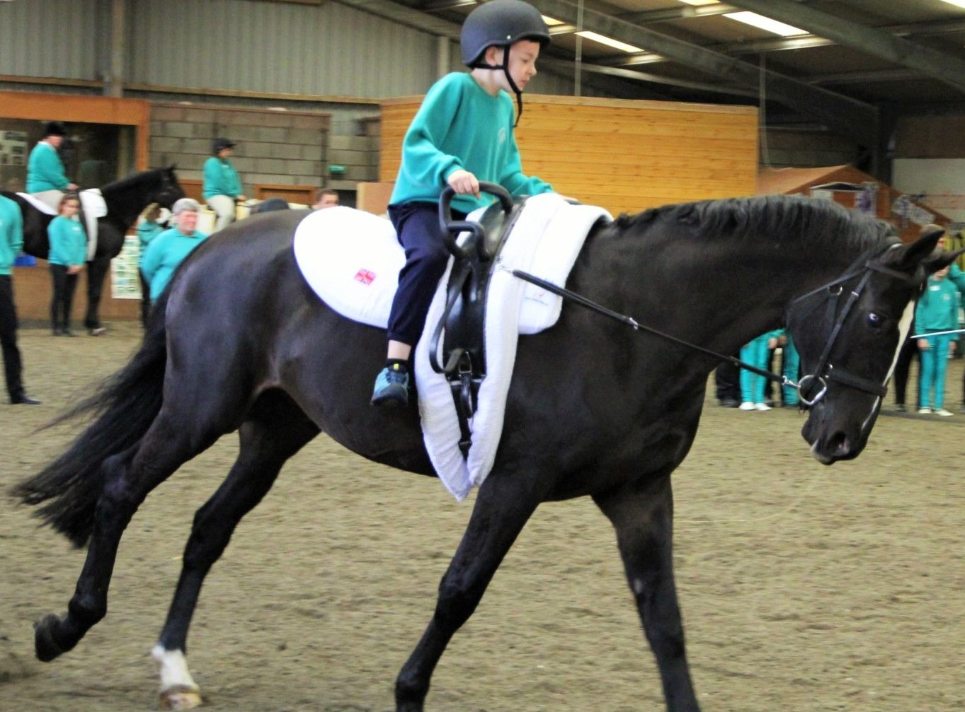

Slide 5
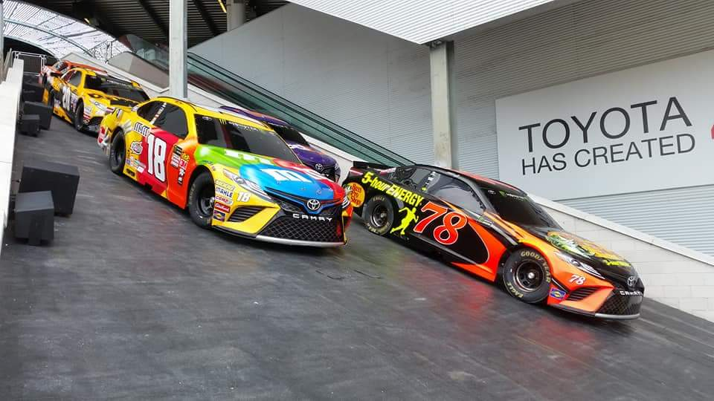
Other things I like
I enjoy lots of sports
I love Formula 1 racing.
I love fast cars.
I enjoy music.
I enjoy swimming, vaulting and riding my scooter.

Slide 6
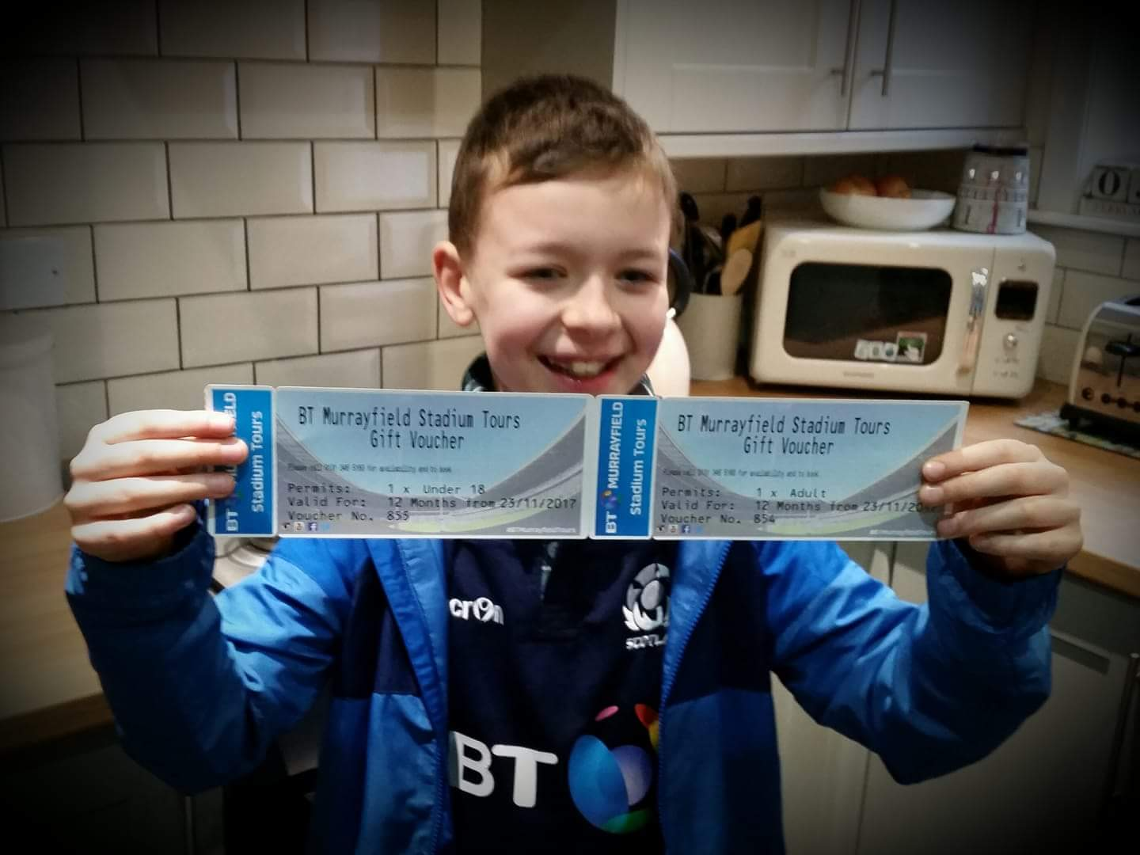
I love going to watch Scotland play rugby.

Slide 7
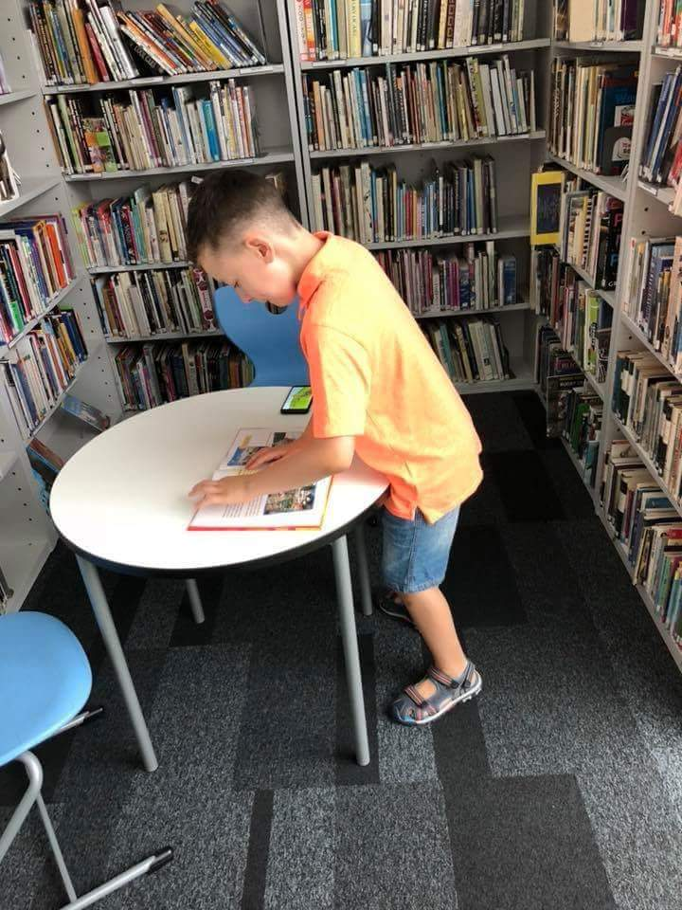
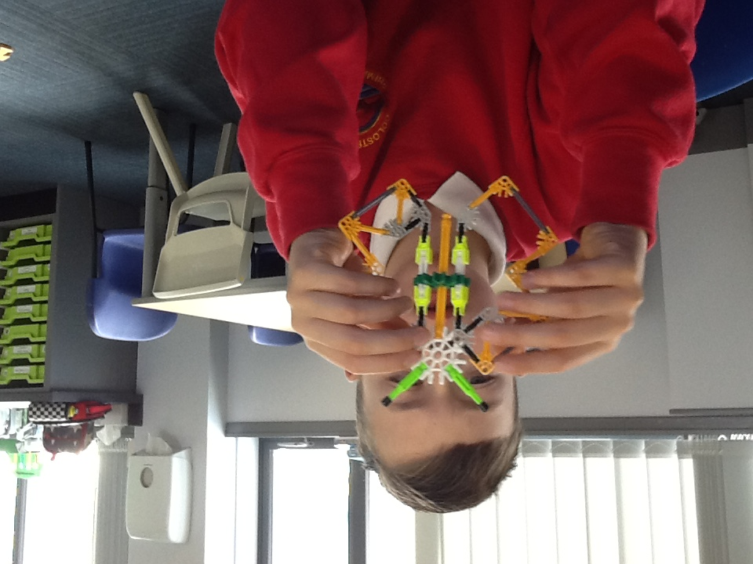
I love making models.
I enjoy reading and books.

Slide 8
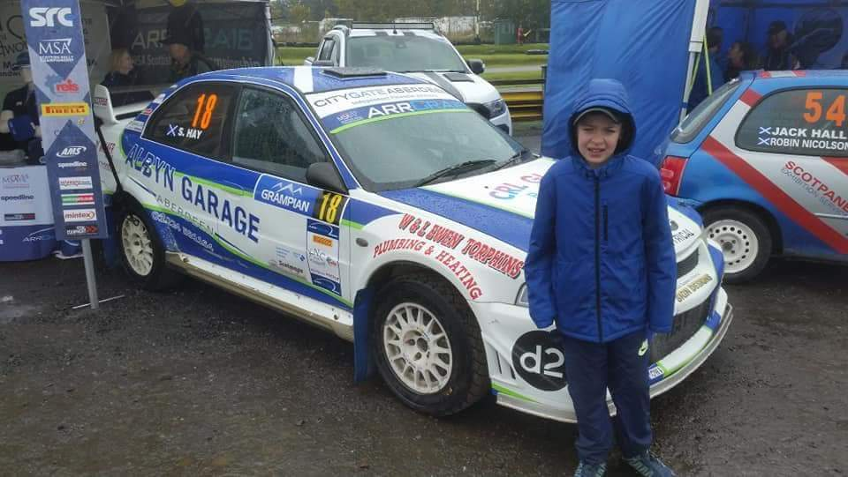
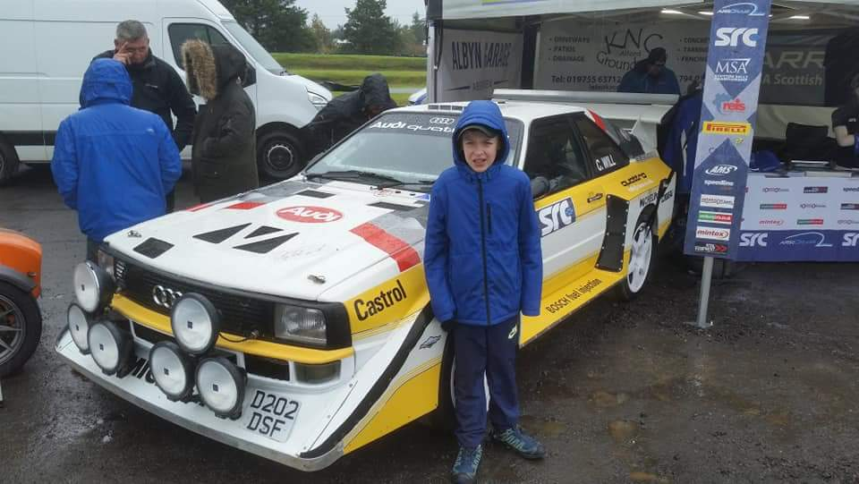
I enjoy all things to do with racing cars – even in the rain.

Slide 9
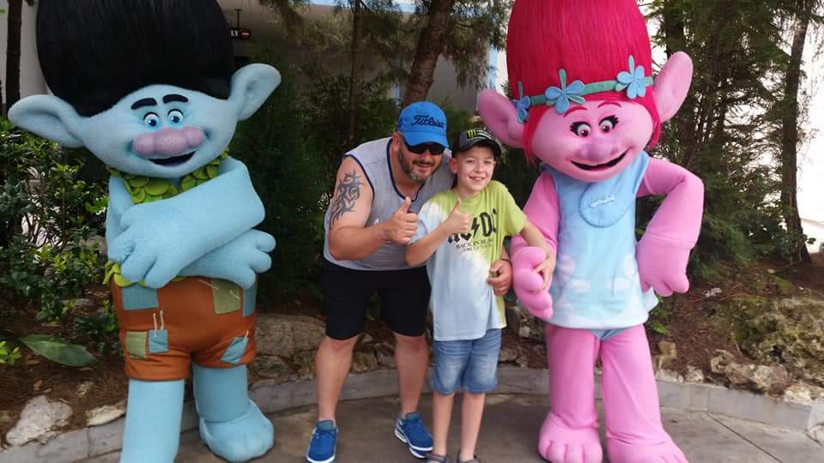
I love my holidays to Florida.

Slide 10
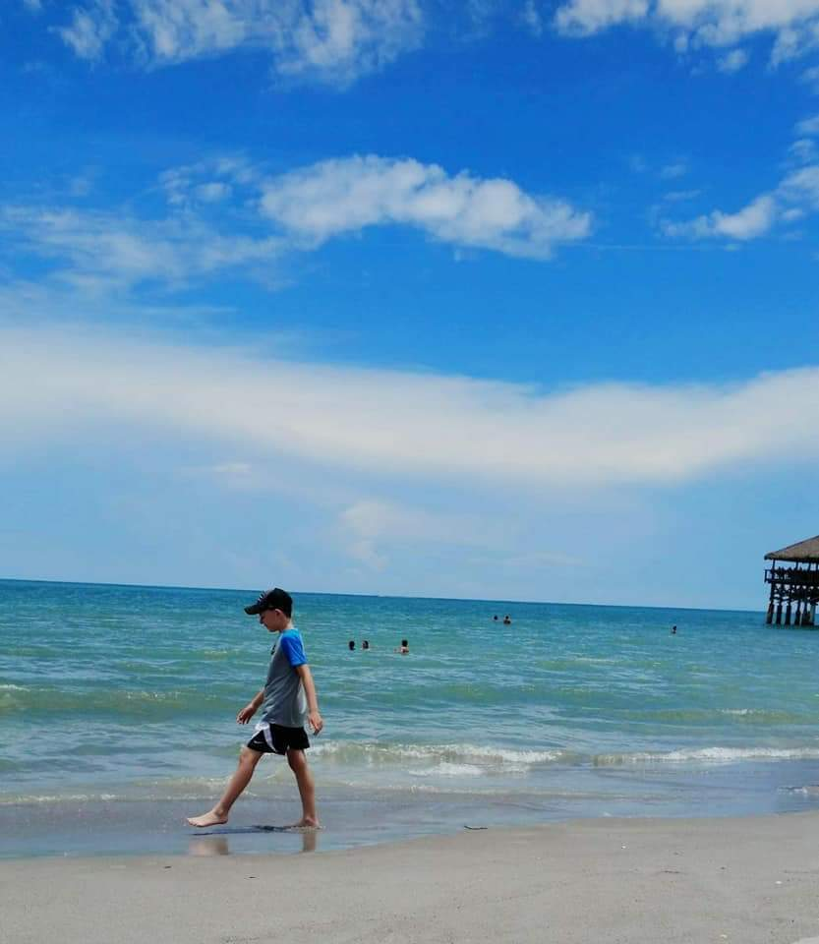
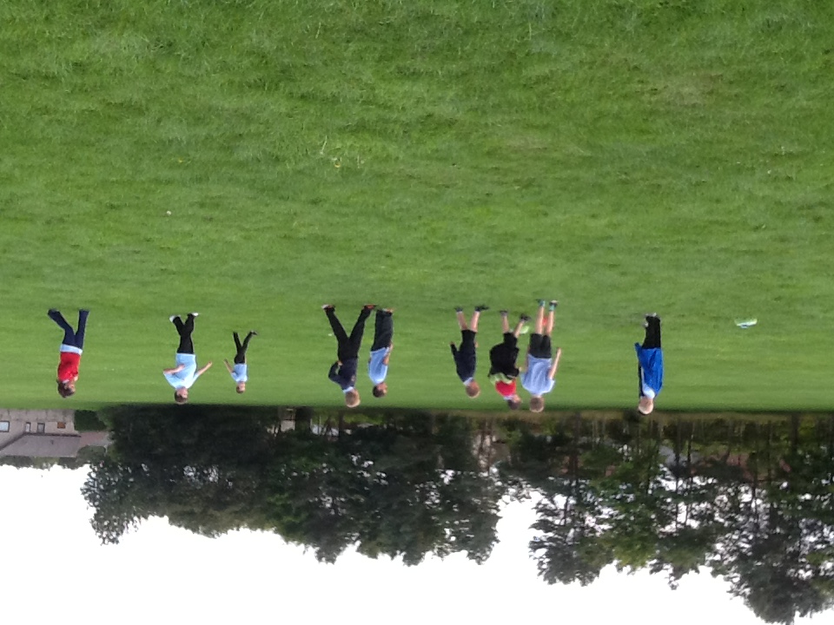
I like being outside.

Slide 11
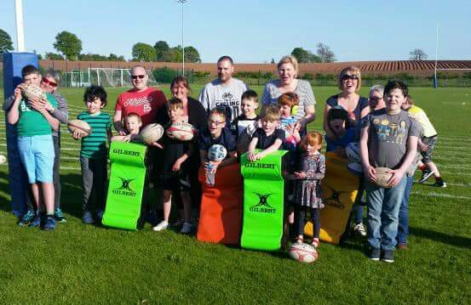
I enjoy the activities I do with my friends at Meeting of Minds.

Slide 12
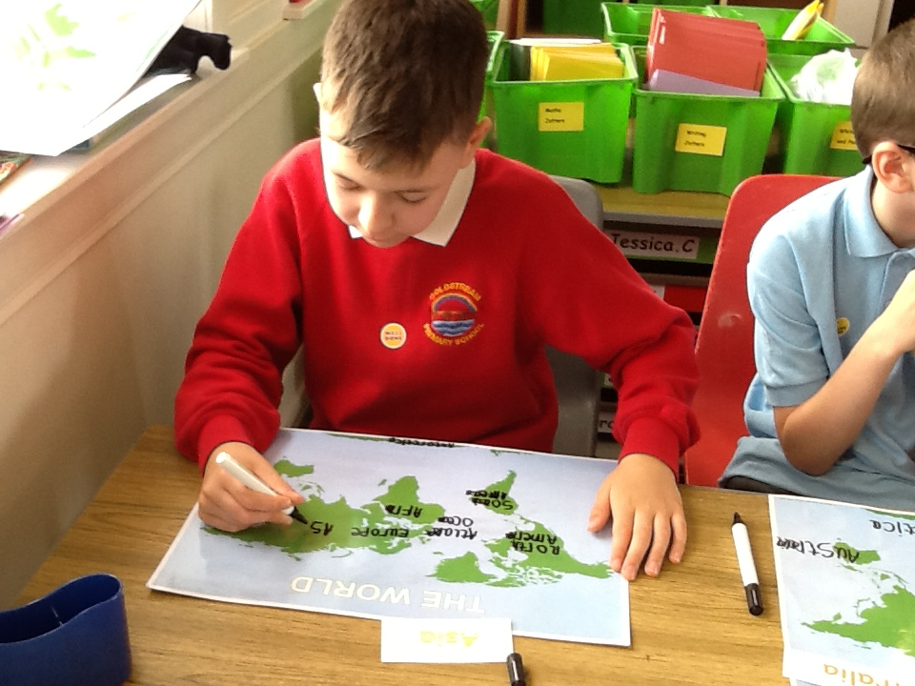
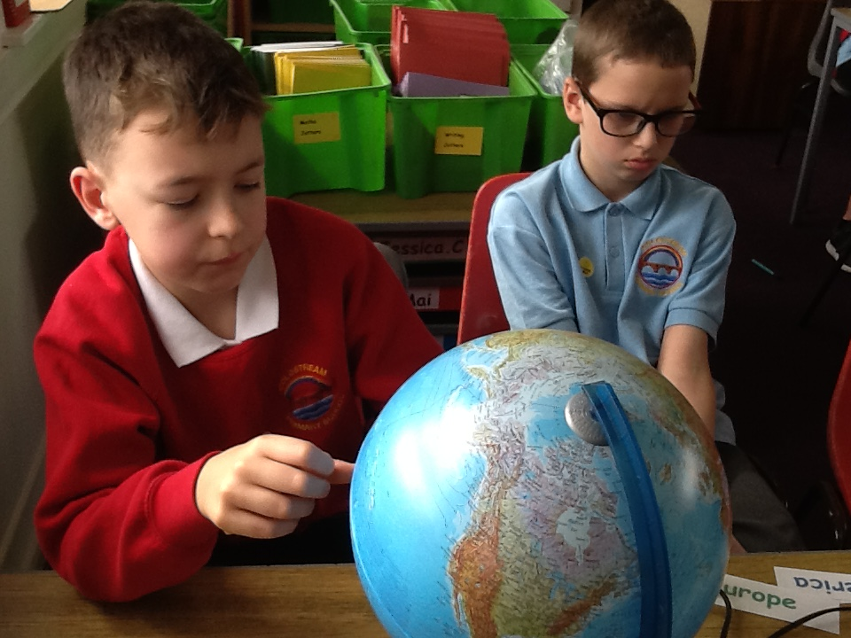
I enjoy finding out about the World.

Slide 13
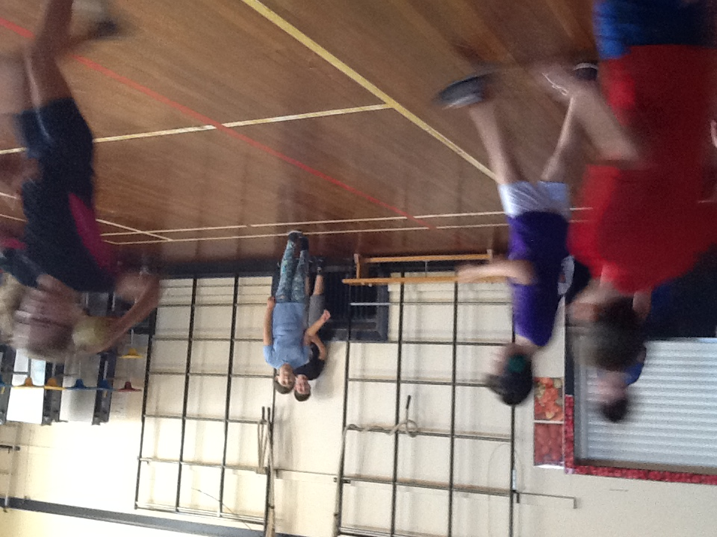
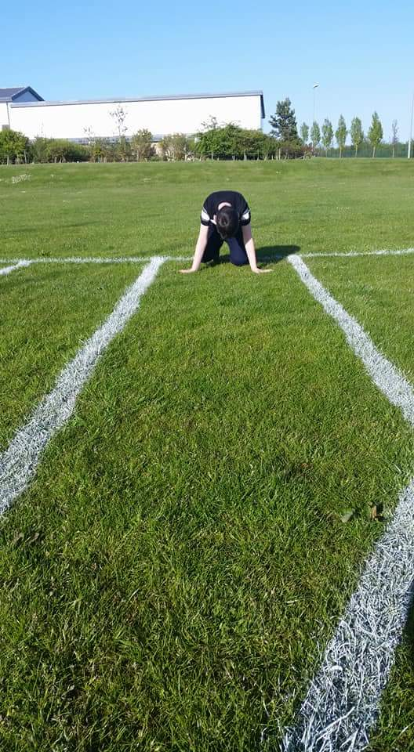
I enjoy PE.

Slide 14
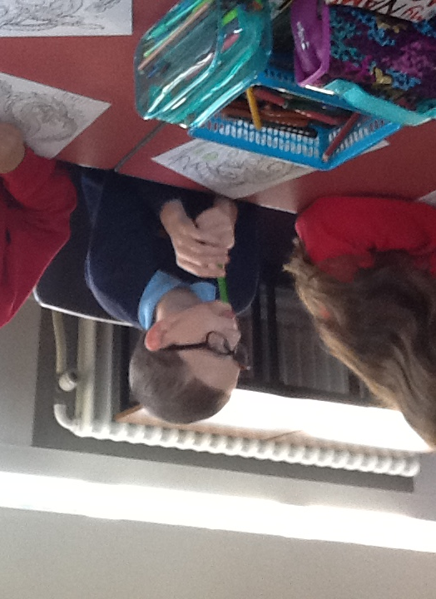
Other things I like
Jigsaws, Lego, the computer, board games, swimming, rugby, football, music, the trampoline, and my scooter.
I love visiting my Granny and Grandad and taking my dogs for a walk.
I enjoy Mindfulness colouring.

Slide 15
Sometimes I don’t understand.
How to help me understand
Speak to me in short, clear sentences
Use simple words
Use signs to help me follow key words you are saying –the signs you can use are
Hello
Goodbye
Play
Please
Thank you
Sorry

Slide 16
So, this is me…………and all I can do is be me.
Like you I am unique.
Please keep playing with me and speaking to me.
Thank you
Charlie

