Slide 2
Who are we?
Meeting of Minds was formed in 2015 by a small group of like-minded and passionate mothers raising a child with additional and complex needs.
​We were united in our struggle to seek local community support and answers from professional agencies in tackling the challenges we faced.
It is with pride that our reputation for dedication and hard work has grown from strength to strength every year in our local area.
We have managed to create and nurture a much-needed support network for families and carers with children who have additional and complex needs.

Slide 3
Our goal
Our goal is to continually strive to spread the word about our ethos, provide more access to key professionals and agencies, more events to educate and inform and more opportunities to connect with others in similar situations.
We are so grateful to all the local individuals, businesses and fellow charities who have supported us throughout our journey and continue to generously donate to our cause.
We have over 250 families/members.
All events are free of charge to our members.

Slide 4
Our philosophy - C A R E
C - CONNECT
With the help of coffee and cake, we gather every few weeks in various locations to meet with similar families. We socialise, chat, share stories and strategies for living well with our children.
A- ACCESS
Once a year we facilitate an opportunity for parents and carers to meet and feedback to key professionals that represent the various services our children use: Education, CAMHS, Social Work, NHS and others.
R - RELAX
We regularly run various fun and inclusive activities for our children: dance, golf, badminton, swimming and arts with lots more to come.
E - EDUCATE
Meeting of Minds offers parents, carers and sibling's events that help to "tool up" for the journey ahead, from mindfulness workshops to presentations by practicing experts in medicine, psychology and psychiatry.

Slide 5
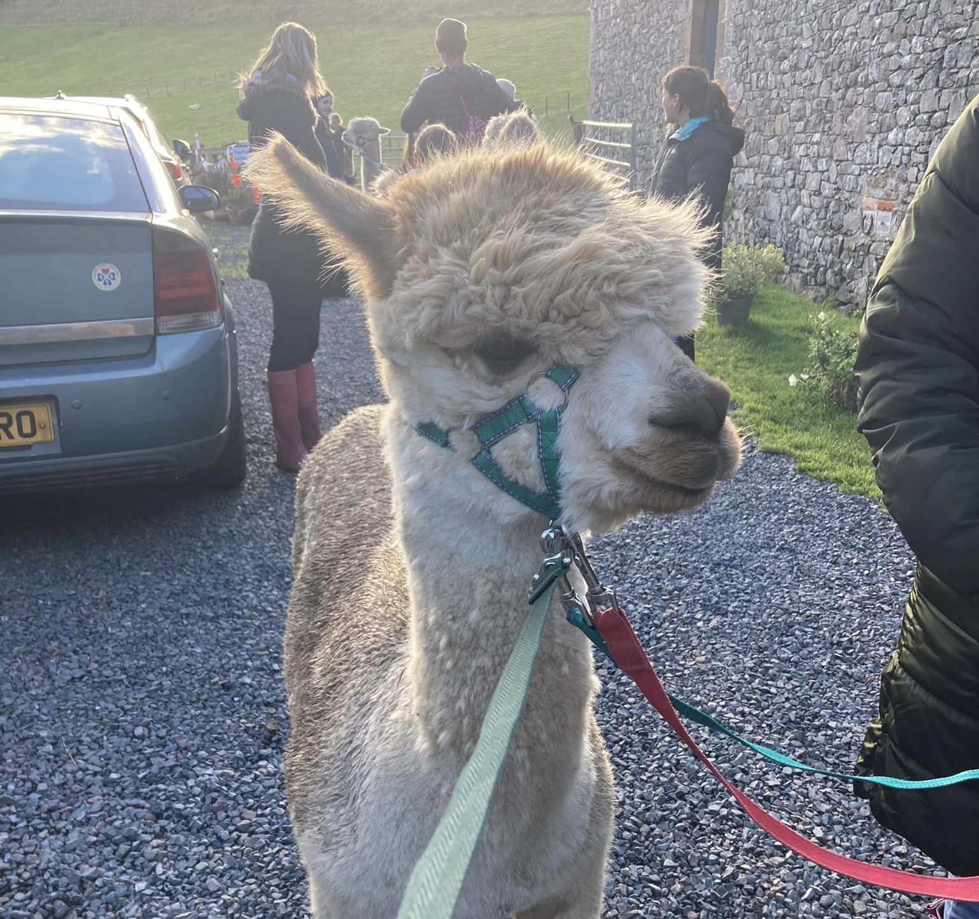
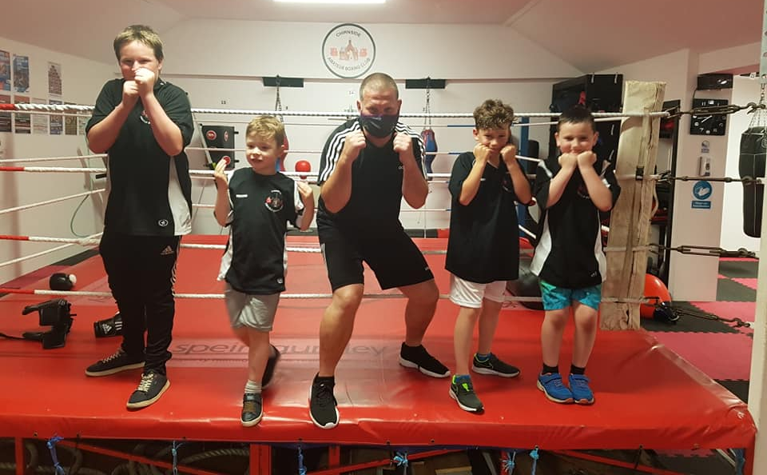
What do we get up to?
Activities we do with our young people/families include:
boxing, swimming, silent discos, alpaca treks, archery

Slide 6
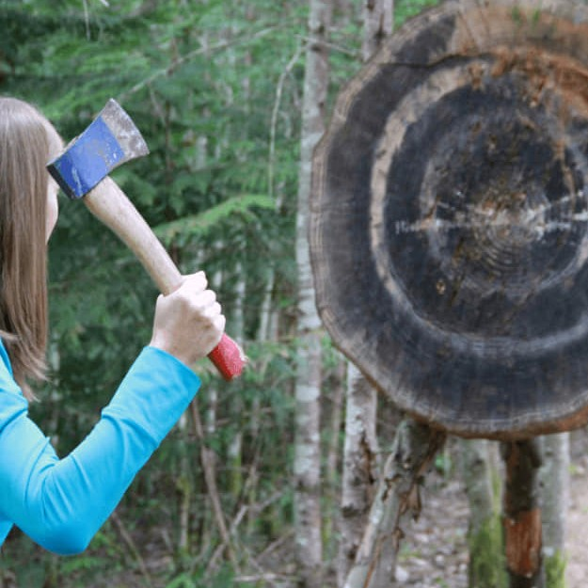
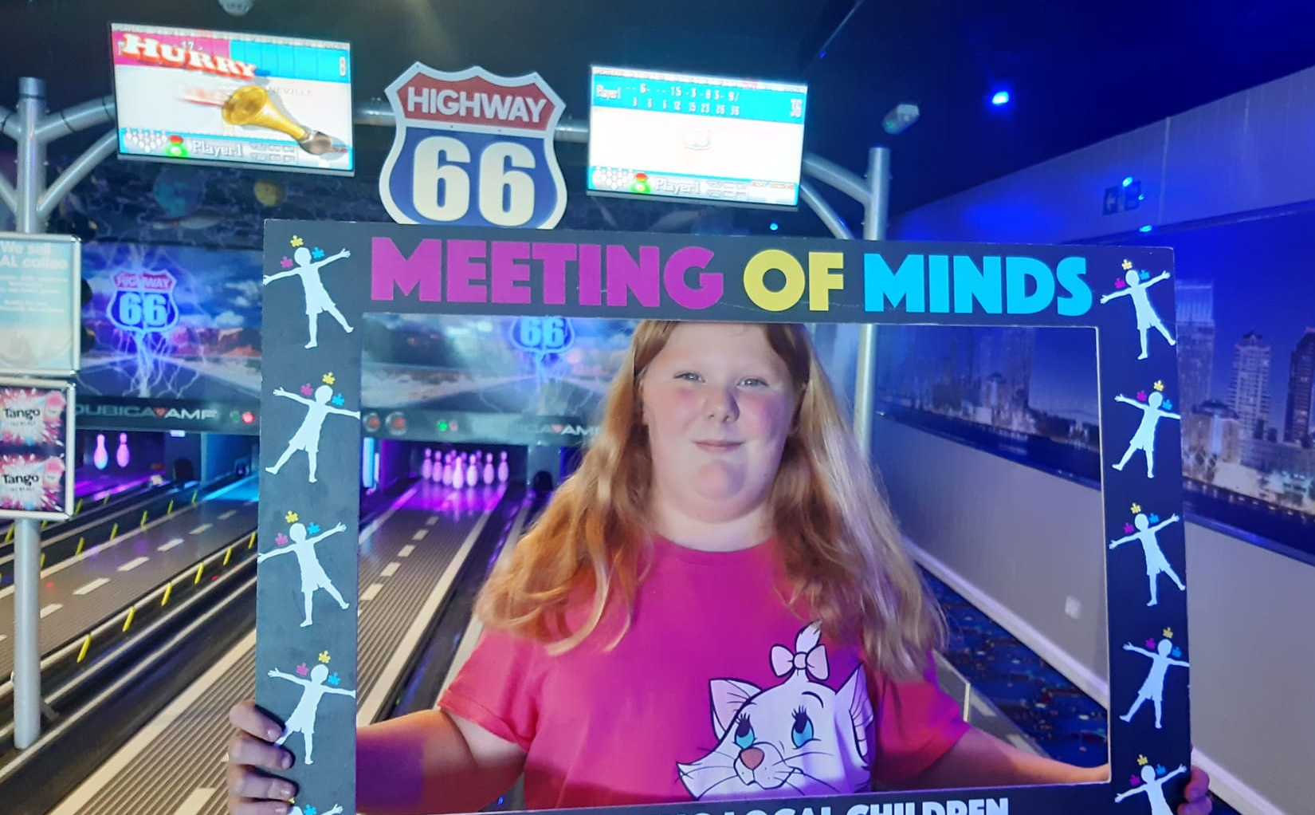
What do we get up to?
tomahawk throwing, hypnosis, outdoor adventures, curling, bowling, ninja warrior and more.

Slide 7
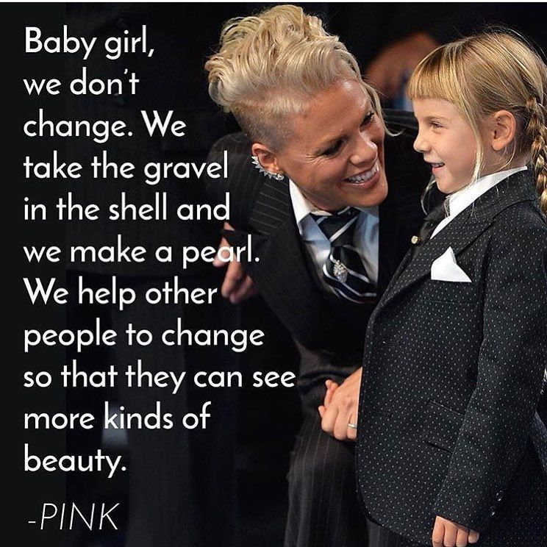
Neurodiversity and creating a better future
Neurodiversity describes the idea that people experience and interact with the world around them in many different ways.
There is no one "right" way of thinking, learning, and behaving, and differences should not be viewed as differences.

Slide 8
The most common neurodiversity myths
Neurodiversity is linked with only Autism
Neurodiverse individuals are all the same/similar
Neurodiverse people cannot succeed in school
Neurodiversity and Mental Health Conditions are the same .
Neurodiverse people cannot communicate efficiently ...
Neurodiversity is a term people use to make others feel better about their disability

Slide 9
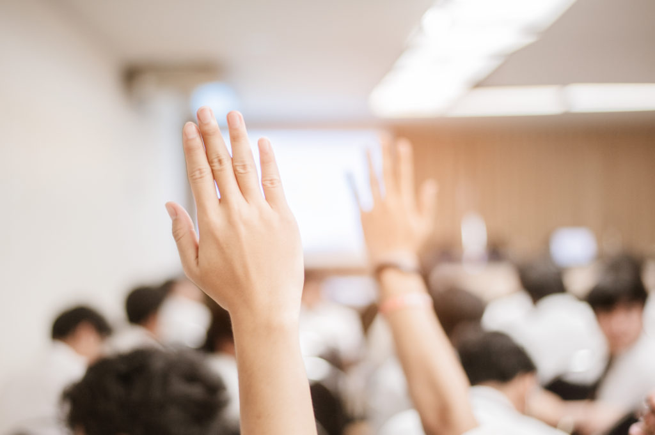
Questions?

